Slide 1





Voice and
Accent
Lecture 2

Slide 2
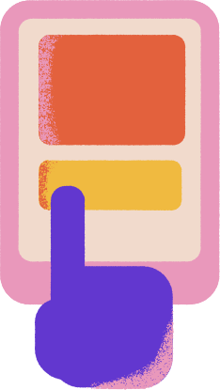

Let’s Learn
Syllables
Word Stress
Content vs. Function Words
Sentence Stress

Slide 3



Introduction
English is a stressed-timed language, it has two types of stresses in intonation: Word Stress; Sentence Stress.
Word stress refers to stressing upon a syllable in the word.
Sentence stress (also called prosodic stress) refers to the emphasis placed on certain words within a sentence.

Slide 4


Syllables
A syllable is an unbroken vowel sound within a word. A vowel sound contains whichever consonants (and other vowels) are attached to a vowel to make a certain, distinct sound.
For example, the word blanket has two syllables: blan + ket.
Sometimes vowels are silent, like in the word grape. Grape has two vowels but only one syllable.
Sometimes two vowels combine to make a single sound; this is called a diphthong. For example, the vowels o + u make an ow sound. The word proud has two vowels but only one syllable.

Slide 5

Practice
Read Aloud and count the number of syllables in the given words
1. Celebrate
a. 2 b. 3 c. 4 d.5
2. Vacation
a. 2 b. 3 c. 4 d.5
3. Conversation
a. 2 b. 3 c. 4 d.5
4. Decision
a. 2 b. 3 c. 4 d.5
5. Photography
a. 2 b. 3 c. 4 d.5
6. Butterfly
a. 2 b. 3 c. 4 d.5
7. Unnecessary
a. 2 b. 3 c. 4 d.5
8. Chocolate
a. 2 b. 3 c. 4 d.5
9. Recommendation
a. 2 b. 3 c. 4 d.5
10. Caramel
a. 2 b. 3 c. 4 d.5

Slide 6
Answers
1. Celebrate - Ce-le-brate (3 syllables)
2. Vacation - Va-ca-tion (3 syllables)
3. Conversation - Con-ver-sa-tion (4 syllables)
4. Decision - De-ci-sion (3 syllables)
5. Photography - Pho-tog-ra-phy (4 syllables)
6. Butterfly - But-ter-fly (3 syllables)
7. Unnecessary - Un-ne-ces-sa-ry (5 syllables)
8. Chocolate - Cho-co-late (3 syllables)
9. Recommendation - Rec-om-mend-a-tion (5 syllables)
10. Caramel - Car-a-mel (3 syllables)

Slide 7
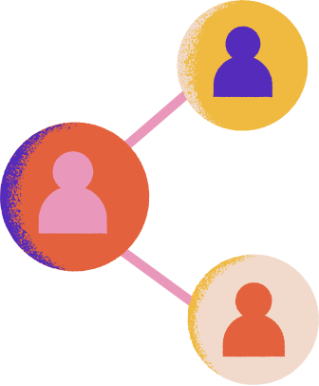
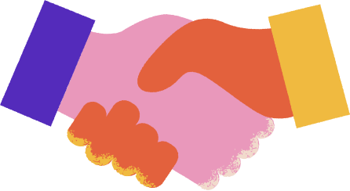
Why does word stress matter?
1. Meaning: Stress can change the meaning of a word. For example, "record" (RE-cord) is a noun, while "record" (re-CORD) is a verb.
2. Pronunciation: Stress affects the pronunciation of individual sounds within a word. Unstressed syllables often have reduced vowels or are pronounced more softly.
3. Intelligibility: Correct stress helps listeners understand words and sentences more easily. Misplaced stress can lead to confusion or misinterpretation.

Slide 8
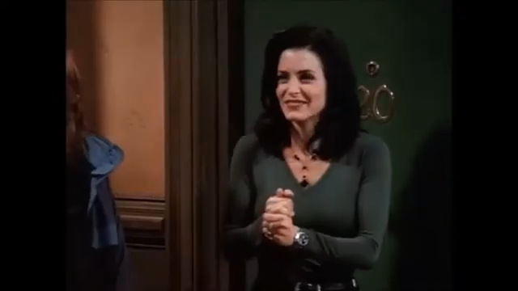

Slide 9

Where to place stress?
Unfortunately, there is no simple rule for determining where the stress falls in a word. However, words with an affix–a prefix or a suffix–will typically alter the stress pattern of a word.
If a word contains a prefix, such as pre-, dis-, ex-, re-, over-, under-, etc., a good rule to follow is that the stress will fall on the first syllable of the root word.
One exception to this pattern, are compound words(nouns), the stress will be placed on the prefix.
For example:
➢ overcoat –> O-ver-coat
➢ output –> OUT-put
For example:
➢ undo –> unDO
➢ overcome –> overCOME

Slide 10
Suffixes are not quite as nice and neat as prefixes. Suffixes often results in one of three stress patterns:
They are stress-neutral — that is, they do not affect the placement of stress
2. When a word ends in “ic,” “sion” or “tion,” the stress is usually on the second-to- last syllable. (penult)
Examples:
➢ creation /cre-A-tion/
➢ photographic /pho-to-GRA-phic/
3. When a word ends in “cy,” “ty,” “phy,” “gy” and “al,” the stress is often on the third-to-last syllable. (antepenult)
Examples:
➢ democracy /de-MO-cra-cy/
➢ photography /pho-TO-gra-phy/
➢ logical /LO-gi-cal/

Slide 11
Do the drill
Drill 1: Word Stress in Nouns
Read aloud the following nouns with correct word stress:
Dictionary - dic-TION-ar-y
Conversation - con-ver-SA-tion
Education - ed-u-CA-tion
Drill 2: Word Stress in Verbs
Read aloud the following verbs with correct word stress:
1. Communicate - com-mu-NI-cate
2. Authorize - au-THOR-ize
3. Cooperate - co-op-er-ATE

Slide 12
Do the drill
Drill 3: Word Stress in Adjectives
Read aloud the following adjectives with correct word stress:
1. Difficult - dif-FI-cult
2. Interesting - in-TER-est-ing
3. Necessary - ne-ces-SA-ry
Drill 4: Word Stress in Sentences
Read aloud the following sentences with correct word stress:
1. The manager is attending the meeting. - The MAN-ager is at-TEND-ing the MEET-ing.
2. The company is launching a new product. - The COM-pa-ny is LAUNCH-ing a NEW PROD-uct.
3. The research team is working on the project. - The RE-search team is WORK-ing on the PRO-ject.

Slide 13
Do the drill
Drill 5: Word Stress in Paragraphs
Read aloud the following paragraph with correct word stress:
"The marketing department is responsible for promoting the company's products. The team is working on a new campaign to increase sales. The manager is attending a meeting to discuss the strategy."
Remember to pay attention to the stressed syllables in each word and sentence. Practice reading aloud to improve your pronunciation and intonation!

Slide 14

Content vs. Function Words
Results
Content Words
Function Words
Content words are those which carry clear meaning, such as:
➢ MAIN VERBS: go, speak, think
➢ NOUNS: house, word, idea
➢ ADJECTIVES: big, difficult, interesting
➢ ADVERBS: slowly, clearly, quite
Function words are grammatical words that glue a sentence together, such as:
➢ AUXILIARY VERBS: are, have, can
➢ PREPOSITIONS: to, from, for
➢ CONJUNCTIONS: and, but, if
➢ PRONOUNS: her, I, their
➢ ARTICLES: a/an, the

Slide 15
Sentence Stress
Sentence stress is generally determined by whether a word is considered a “content word” or a “function word,” and the vocal space between stressed words creates the rhythm of a sentence.
Content words will always have at least one syllable that is emphasized in a sentence, so if a content word only has a single syllable, it will always be stressed.
Function words, especially those with only one syllable, are commonly (but not always) unstressed in a sentence—since they are not providing lexical meaning integral to the sentence

Slide 16
Sentence Stress
For example, in the sentence,
“Bobby wants to walk to the playground”, the particle to, the preposition to, and the definite article “the” are all said without (or without much) stress.
The content words (Bobby, wants, walk, and playground), on the other hand, each receive more emphasis to help them stand out and underline their importance to the meaning of the sentence.

Slide 17
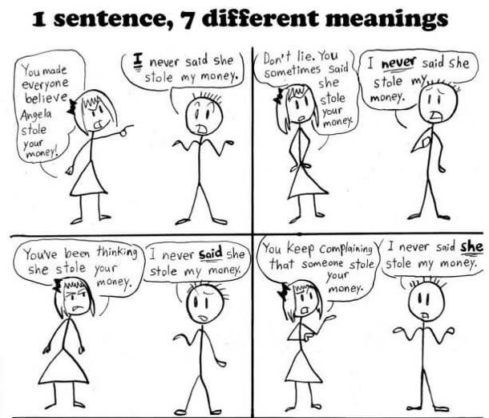
Practice

Slide 18
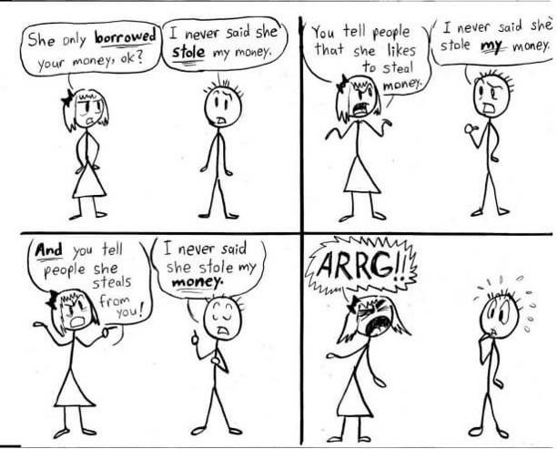
Practice

Slide 19


Thank You

